Slide 1
Report on the "Survey on Water Server Usage Frequency and Rate of My Bottle Users" (FY2023)
September 22nd 2023
Office of Sophia Sustainability Promotion

Slide 2
Table of Contents：
１．Survey Objectives and Overview・・・・・・・・・・ Page 2～5
２．Number of uses per day of the week・・・ ・・ ・・ Page 6
３．Number of uses per day per location・・・・・ ・・ ・ Page 7
４．Frequency of uses in one day and estimated savings ・ Page 8～9
５．Percentage of MyBottle users ・・・・・・・・・・・ Page 10
６．Summary ・・・・・・・・・・・・・・・・・・・・ Page 11
Survey Summary：
Office of Sophia Sustainability Promotion has installed water servers on campus since 2021 with the aim to promote equal access to safe water and de-plasticization through the use of My Bottle and contribute to achieving SDG 6, 12, 13, and 14. Since the COVID-19 situation eased and restrictions on entering the campus loosened the demand for water servers substantially increased. However, no data measurement had been conducted on the usage and effectiveness of the water servers that were additionally installed from 2022 and onward. Therefore, the Office of Sophia Sustainability Promotion conducted a survey on the frequency of use and the percentage of students who use their own bottles in order to understand the current status of water servers, promote the use of "My Bottle" and take this data into account for future management and improvements.

Slide 3
Survey Objective：
・To assess the number of times water servers are used and to improve resource management and efficiency.
・ To evaluate the university's efforts to reduce single-use containers by surveying the number of students who bring their own bottles to campus. This will be useful in formulating future measure.
・To assess the effectiveness of water servers introduction and the promotion of “My Bottle” usage in reducing plastic waste on campus
・ To identify the extent of cost savings (beverage costs) for water servers users and encourage their use.
・To assess the congestion status of water servers and promote the dispersion of usage.
Implementation Period： ① Survey on the percentage of respondents who bring their own bottle：June 12th (Monday) ~ June 16th (Friday) between 12:30～13:30
② Survey on the frequency of use：June 19th (Monday) ~ June 23rd (Friday) between 9:00～17:00

Slide 4
Survey Method ① Usage frequency survey by day of the week and location: Counters were set up at 12 water servers on campus, and users were asked to press a button each time they used the water server. ② Daily usage frequency survey: During one hour of lunch break, we interviewed water server users situated outside of Building No. 2 and Building No. 11 about their daily water server usage frequency. ③ My Bottle water server users: During one hour of lunch break, we recorded the number of water server users who refilled either with MyBottle or PET bottle outside Building No. 2 and Building No. 11.

Slide 5
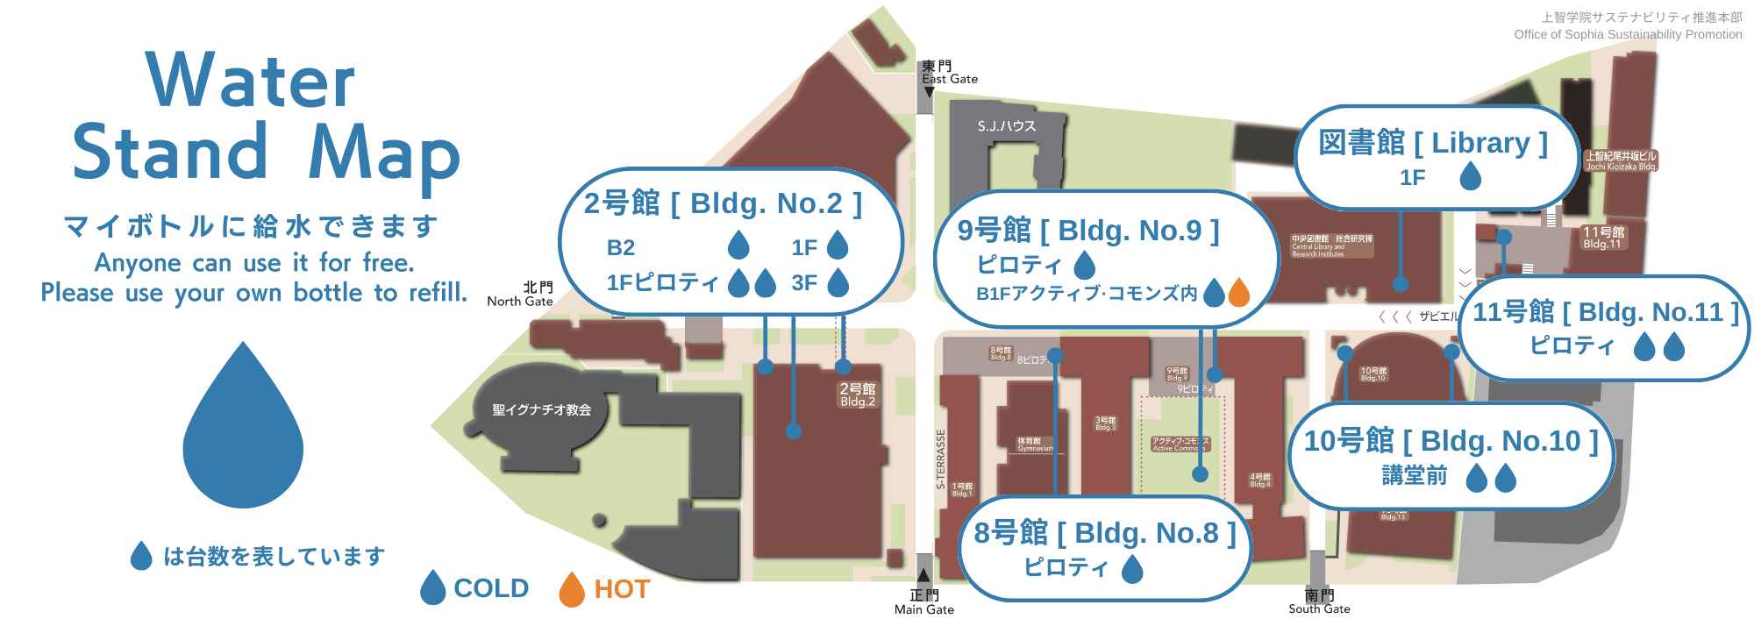
Water Server Access Map

Slide 6
Number of uses per day of the week (total of 12 servers)
Day of the week | Number of Uses
Monday | 7,158
Tuesday | 7,869
Wednesday | 7,779
Thursday | 6,447
Friday | 6,174
Total | 35,426
Average | 7,085
※ Data has been corrected for cases where the counter mistakenly incremented
Based on results of survey conducted between from June 19th (Monday) to June 23rd (Friday), the day with the highest number of uses was Tuesday, with 7,869 uses, followed by Wednesday with 7,779 uses, and Monday with 7,158 uses. With this, there were a total of 35,426 uses in one week, averaging to 7,085 uses per day. In simple calculations, dividing the weekly usage frequency of 35,426 uses by the total number of students 14,573, equals 2.43, which means that Sophia University students/faculty uses the water server on average 2.4 times per week.

Slide 7
Number of uses per day per location (Average)
Location | No. of Uses
Bld.2 Floor B2 | 361
Bld.2 Floor 1 | 1,150
Bld.2 North Gate Side | 1,285
Bld.2 Central Side | 1,269
Bld.2 Floor 3 | 1,169
Library Floor 1 | 358
Bld.9 Basement(Left) | 66
Bld.9 Basement(Right) | 71
Bld.10 Front of Library | 110
Bld.10 Near Bld.14 | 329
Bld.11 (Left) | 1,039
Bld.11 (Right) | 685
Bld.2 Floor B2
Bld.2 Floor 1
Bld.2 North Gate
Bld.2 Central Gate
Bld.2 Floor 3
Library Floor 1
Bld.9 Basement Left
Bld.9 Basement Right
Bld.10 Front Library
Bld.10 Near Bld.14
Bld.11 Left
Bld.11 Right
After a week of investigation, the results indicate that among 12 water servers the most frequently used are Bld.2 North Gate Side (1,285), Bld.2 Central Side (1,269) and Bld.2 Floor 3 (1,169). This suggests that water servers in Building 2 are most frequently used. This is likely due to the absence of water servers in Building 6, which is frequented by many students as well as due to its installation location which is near the main street where many students commute through.

Slide 8
Survey on the frequency of uses in one day
Frequency of Use per day | No. of People
1 Time | 480
2 Times | 355
3 Times | 166
4 Times | 64
5 Times | 39
Total | 1,104
Frequency of Uses
1
2
3
4
5
Between June 12th (Monday) and June 16th (Friday), during the lunch hour from 12:30 to 13:30, we interviewed 1,104 students who were using the water servers located at Building 11 and Building 2 Central Side, where it was anticipated to have the greatest number of users present. The survey aims to determine the frequency of water server usage in a day among students. The results showed that the majority of users, 480 of them, use the water server once a day, followed by 355 students using it twice a day and 166 students who use it three time a day.

Slide 9
Daily Usage Frequency Ratio and Savings Estimations through MyBottle Usage
Frequency of Use per day | 1 Day | *1 Week （５Days） | 1 Month | *1 Year （８ Months）
1 Time | 90円 | 450円 | 1,800円 | 14,400円
2 Times | 180円 | 900円 | 3,600円 | 28,800円
3 Times | 270円 | 1,350円 | 5,400円 | 43,200円
4 Times | 360円 | 1,800円 | 7,200円 | 57,600円
5 Times | 450円 | 2,250円 | 9,000円 | 72,000円
1
2
3
4
5
※*1 week excludes Saturdays and Sundays; 1 year excludes spring break and summer vacation.
Looking at the percentages, 43.5% of the students drink water once a day, 32.2% twice a day, and 24.3% three or more times a day. Assuming that students who bring their own water bottles can save the cost of purchasing a bottled water (90 yen) per water refill, simple calculations show the students who use the water server once per day can save 90 yen a day, 450 yen a week, 1,800 yen a month, or 14,400 yen a year. With the saving estimations increasing with increased frequency of use.

Slide 10
Percentage of users bringing their MyBottles
Bld.2 Central Side
Bld.11 (Left & Right)
Day | MyBottle Users | PET Bottle Users | Total | Percentage of MyBottle Users
Monday | 25 | 59 | 84 | 29.8%
Tuesday | 98 | 51 | 149 | 65.8%
Wednesday | 38 | 63 | 101 | 37.6%
Thursday | 65 | 45 | 110 | 59.1%
Friday | 68 | 51 | 119 | 57.1%
Total | 294 | 269 | 563 | 52.2%
Day | MyBottle Users | PET Bottle Users | Total | Percentage of MyBottle Users
Monday | 52 | 64 | 116 | 44.8%
Tuesday | 108 | 73 | 181 | 59.7%
Wednesday | 50 | 34 | 84 | 59.5%
Thursday | 64 | 44 | 108 | 59.3%
Friday | 68 | 36 | 104 | 65.4%
合計 | 342 | 251 | 593 | 57.7%
From June 12 (Mon.) to June 16 (Fri.), during a one-hour period from 12:30 to 13:30, we measured the number of people who used their MyBottle at the two water servers located in the pilotis of Building No. 11 and one in the central area outside Building No. 2, where the number of users was expected to be highest. On most days of the week, more than 50% of the respondents used their own bottles (MyBottle). Other days, the number of users refilled with empty bottles (repeated use), which is thought to be contributing to the reduction of plastic bottle waste.

Slide 11
Summary：
● Simple calculation, 35,426 times use per week / 14,573 total students = 2.43 times, which means that Sophia students use the water server about 2.4 times per week.
●The most used area out of the 12 water servers is Building No. 2 North Gate with 1,285 times/day, followed by Building No. 2 Central area with 1,269 times/day, and Building No. 2 third floor with 1,169 times/day.
●According to the survey, the majority of students (480) uses the water server once a day, followed by 355 who used it twice a day, and 166 who used it three times a day.
●The results of the survey showed that students who use the water server once a day can save approximately 90 yen a day, 450 yen a week, 1,800 yen a month, and 14,400 yen a year.
●The percentage of students who used their MyBottles for water refill exceeded 50% on almost all days of the week.

Slide 12
For inquiries regarding this material, please contact :
Office of Sophia Sustainability Promotion
ossp@ml.sophia.ac.jp

